Slide 1
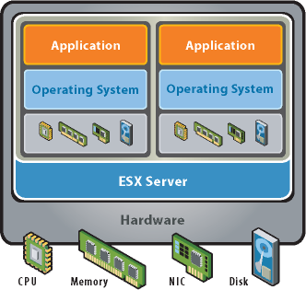
Virtualization Case study in layering, abstraction, and naming
VMM
CS522 – Principles of Computer Systems
Edouard Bugnion
Notes:
AKA Redundancy, Voting and Consensus

Slide 2
Virtual machines– undergraduate lecture
Fundamental Attributes:
Equivalence – essential identical environment
Performance – nearly the same speed
Safety – the VMM is in complete control
VMM
The Popek / Goldberg Principles [1974]

Slide 3
Popek and Golberg: Proving it formally [1974]
For any conventional computer, a virtual machine monitor may be constructed if the set of sensitive instructions for that computer is a subset of the set of privileged instructions.
Proof by construction (of the VMM)

Slide 4
The proof
All you need is a minimalistic architecture with support for:
Kernel mode and user mode
Virtual memory (e.g. via segmentation)
Don’t screw up the instruction set architecture
Don’t screw up virtual memory
Sketch the implementation of the VMM that
Runs the application in user mode
Runs the kernel in user mode
Q.E.D.
Details are in the paper (how hard can it be)

Slide 5
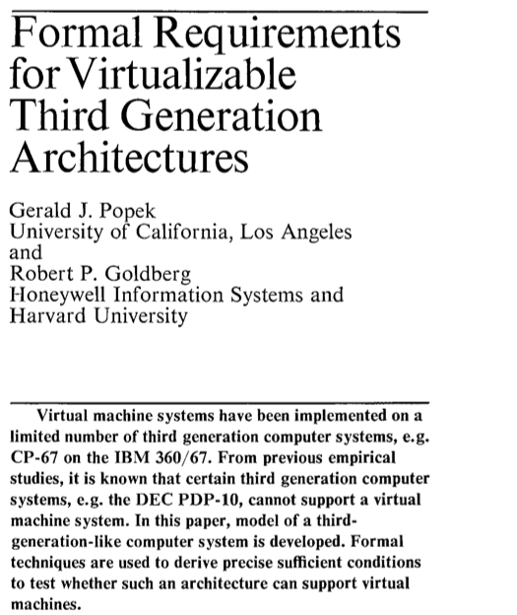
Great contributions from 1974
CACM ‘74
ABBA ‘74

Slide 6
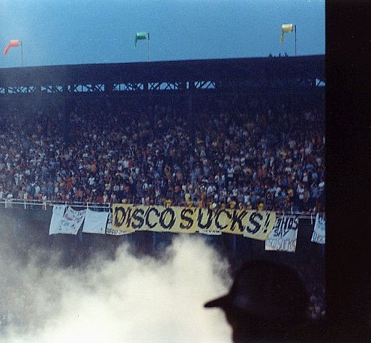
Great corrections since 1974
Disco Demolition night, Chicago, IL, 7/12/1979
ABBA ‘74

Slide 7
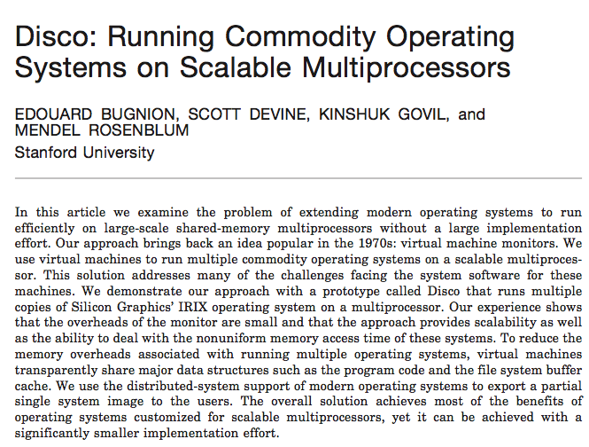
Known corrections following 1974
Well-known violations of the P/G theorem:
The DEC PDP-10
The MIPS architecture [85]
The 80386 (with v8086) [85]
The Pentium (no change) [93]
The ARM architecture [85]
…
CACM ‘74
SOSP ’97, TOCS ‘97

Slide 8
Stanford FLASH + Disco
IRIX
IRIX
IRIX
IRIX
SPLASHOS
Disco
Disco – highly-scalable Virtual Machine Monitor
Uses virtual machines to create a virtual cluster
Runs commodity OS in virtual machines
Challenge – how to approximate a single system image
At least from an efficiency perspective …
… with mostly unmodified operating systems
Totally academic treatment

Slide 9
From Disco to VMware
Stick with MIPS servers
Port to Alpha servers and support Windows, VMS, ULTRIX
Disco: designed for big UNIX servers
Prove on desktops
Roadmap servers

Slide 10
The 3rd theorem from Popek and Goldberg [1974]
A hybrid virtual machine monitor may be constructed for any conventional third-generation machine in which the set of user-sensitive instructions are a subset of the set of privileged instructions.
“If you only screw up the architecture for kernel mode, you can still use direct execution while handling user mode”

Slide 11
VMware Workstation [1999] ^{[TOCS 2012]}
Equivalence – essential identical environment (minor holes)
Performance – mostly
Safety – yes
Encapsulation – checkpoint → live migration
Hardware-independence – I/O emulation
Non-rev. segments
DBT
cpl=0
DE
real mode
iopl=3
New attributes would prove essential for the cloud

Slide 12
Virtualization today – hardware support
Ubiquitously deployed, with broad hardware support:
CPU – VT-x, AMD-v and ARM-v
MMU – Extended Page Tables (aka Nested Page Tables)
Interrupts – vAPIC, ELI, …
I/O Bus – IOMMU
I/O Device – SR-IOV
Network Virtualization / overlays: VXLAN, Geneve, …
And yet:
Segments were removed in x86-64 …. Breaks application sandboxing
Intel introduced SGX (conf. apps) but the future is TDX (conf. VM)
Caution: history might repeat itself !

Slide 13

Quiz
Why does the cloud use VMs ?

Slide 14
Virtualization today – a foundation for:
Scalable multi-tenancy (a.k.a. “cloud”)
Server consolidation
Storage consolidation and virtualization
Appliance distribution
High-availability
Live migration / Distributed resource scheduling
Network virtualization
Hyper-converged deployments (server + storage + network functions)
…

Slide 15
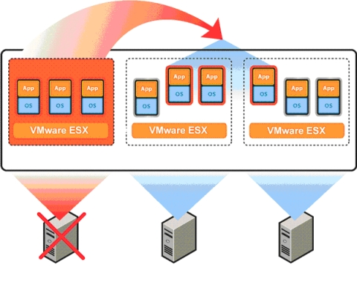
Virtual Machine High Availability
Decouple VM from underlying hardware
Ensure that it restarts on another node in the case of a failure

Slide 16
In-class design project

Slide 17

Design an Hyper-converged virtual infrastructure
VM
VM
VM
Hypervisor
CPU++Mem
FLASH
DISK
DISK
DISK
DISK

